Slide 1
Haptic Fitness CSED404 Final Presentation
Team TCPs / Member Chan-ki Hwang & Taeyeon Kim

Slide 2
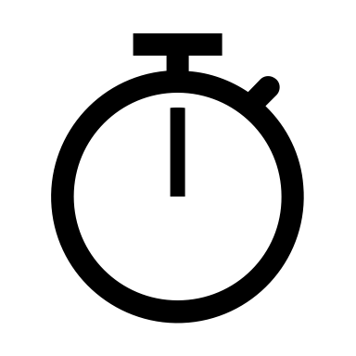

Vibration feedback to user’s action
Real-time
No delay between vibratory feedbacks
Directive
set proper Vibration patterns according to range
Dynamic feedback on specific event, interval…
Attach on the body to fetch user’s position

Slide 3


Current Implementations
VibrationEffect
For various strength of feedback
Modular
Baseline had implemented!
(Acceleration Condition) → (Vibration Pattern?)

Slide 4
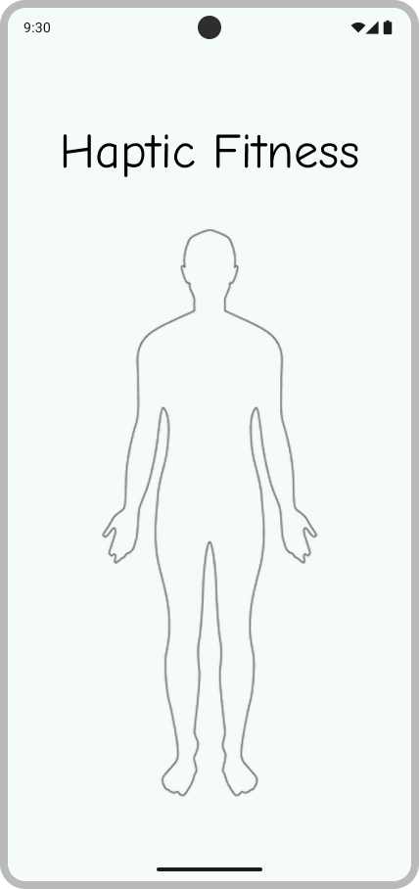
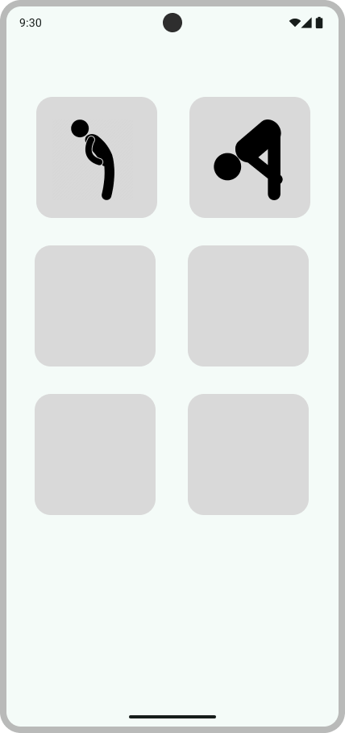
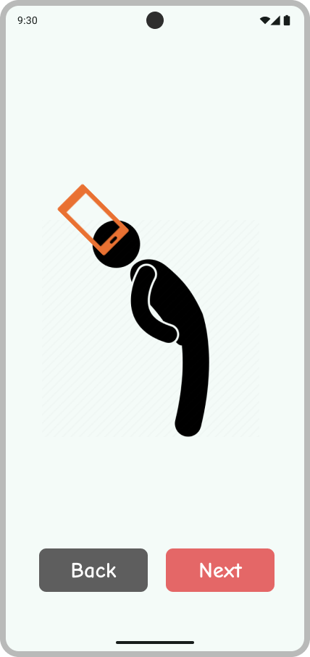
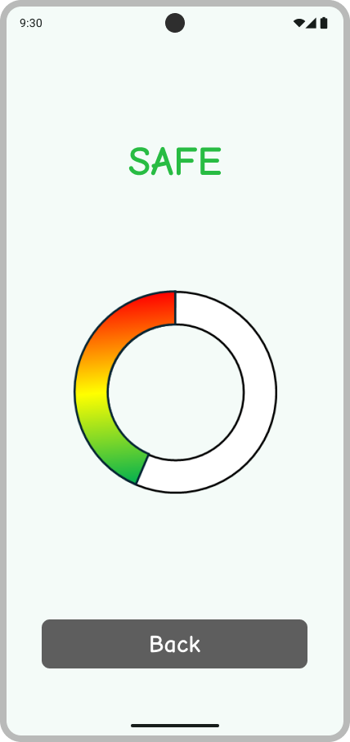
Basic UI

Slide 5
Code Implementation
CreateView
Sensor Init
S
S
Vibrator Init
V
V
Thread Init
Th
Th
DestroyView

Slide 6
Code Implementation
CreateView
Sensor Handling
Looper
Vibration Generate
Looper
Sensor Init
Vibrator Init
onSensorChanged
post
post
Array<> .forEach
VibratorManager. vibrate
Thread Init
Array<(Int) -> CombinedVibration?>
pattern
DestroyView

Slide 7
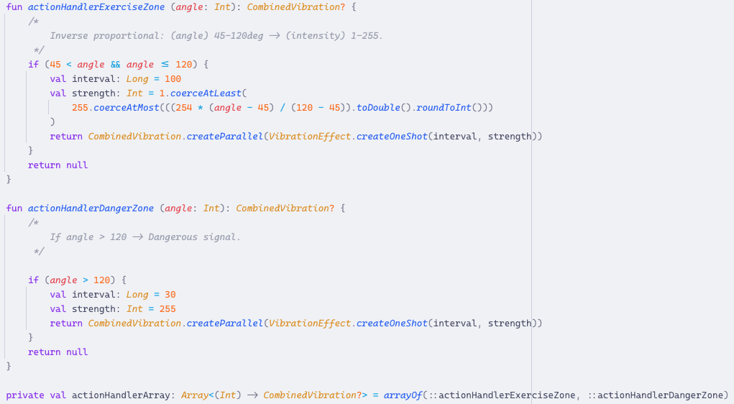
Code Implementation
Modularity!

Slide 8



Examples
TOGGLE_ON
TOGGLE_OFF
TOGGLE_ON
TOGGLE_OFF
REJECT
“SAFE”
“MORE”
REJECT
“MORE”
“SAFE”
Start/Stop Exercise
Start/Stop Exercise
REJECT
“DANGER”
REJECT
“DANGER”

Slide 9

Examples
TOGGLE_ON
TOGGLE_OFF
REJECT
“SAFE”
“MORE”
REJECT
“DANGER”
Start/Stop Exercise

Slide 10
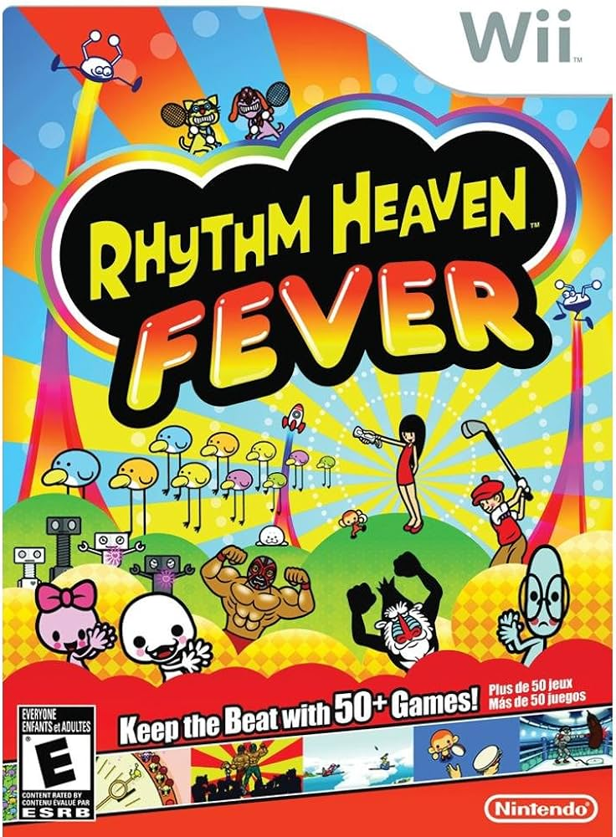
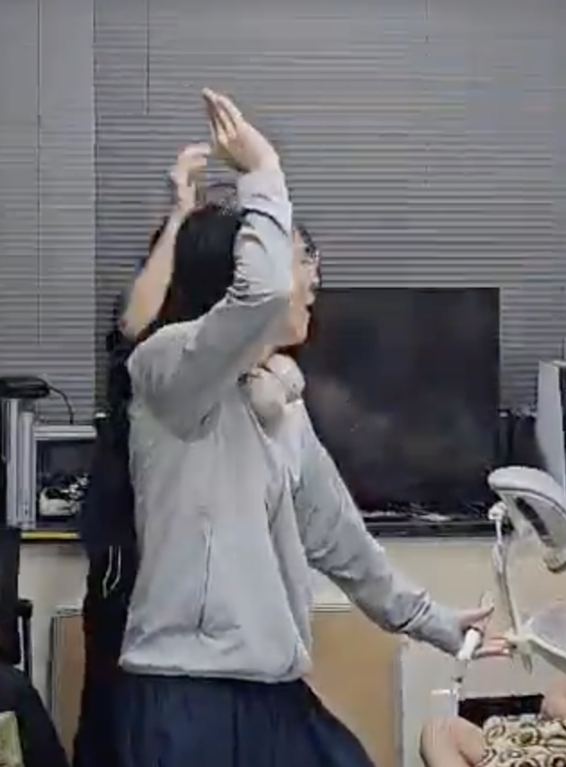

Rhythm Fitness?
APTIC
WE DID IT!

Slide 11

Rhythm Fitness Implementation
But, How to detect
PROPER movement?
+y
+x
THRESHOLD
0
+z
THRESHOLD
←→↑↓⨀⨂

Slide 12

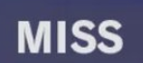

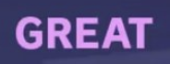
Rhythm Fitness Detection
Lightweight
Reliable
Compatible to modern rhythm games
t
t
Δt
0
0
0

Slide 13
Rhythm Fitness Detection?
Lightweight X
Reliable X
Compatible to modern rhythm games
pointer
queue<Double>(WINDOW_SIZE)
0
Feedback
SLOW
FAST
Judgement Algorithm
PERFECT

Slide 14
Rhythm Fitness Detection?
Lightweight OK
Reliable OK
Compatible to modern rhythm games
queue<Double>(WINDOW_SIZE)
Double avg = avg * T + sensor * (1–T)
avg
0
Feedback
Judgement Algorithm
PERFECT

Slide 15
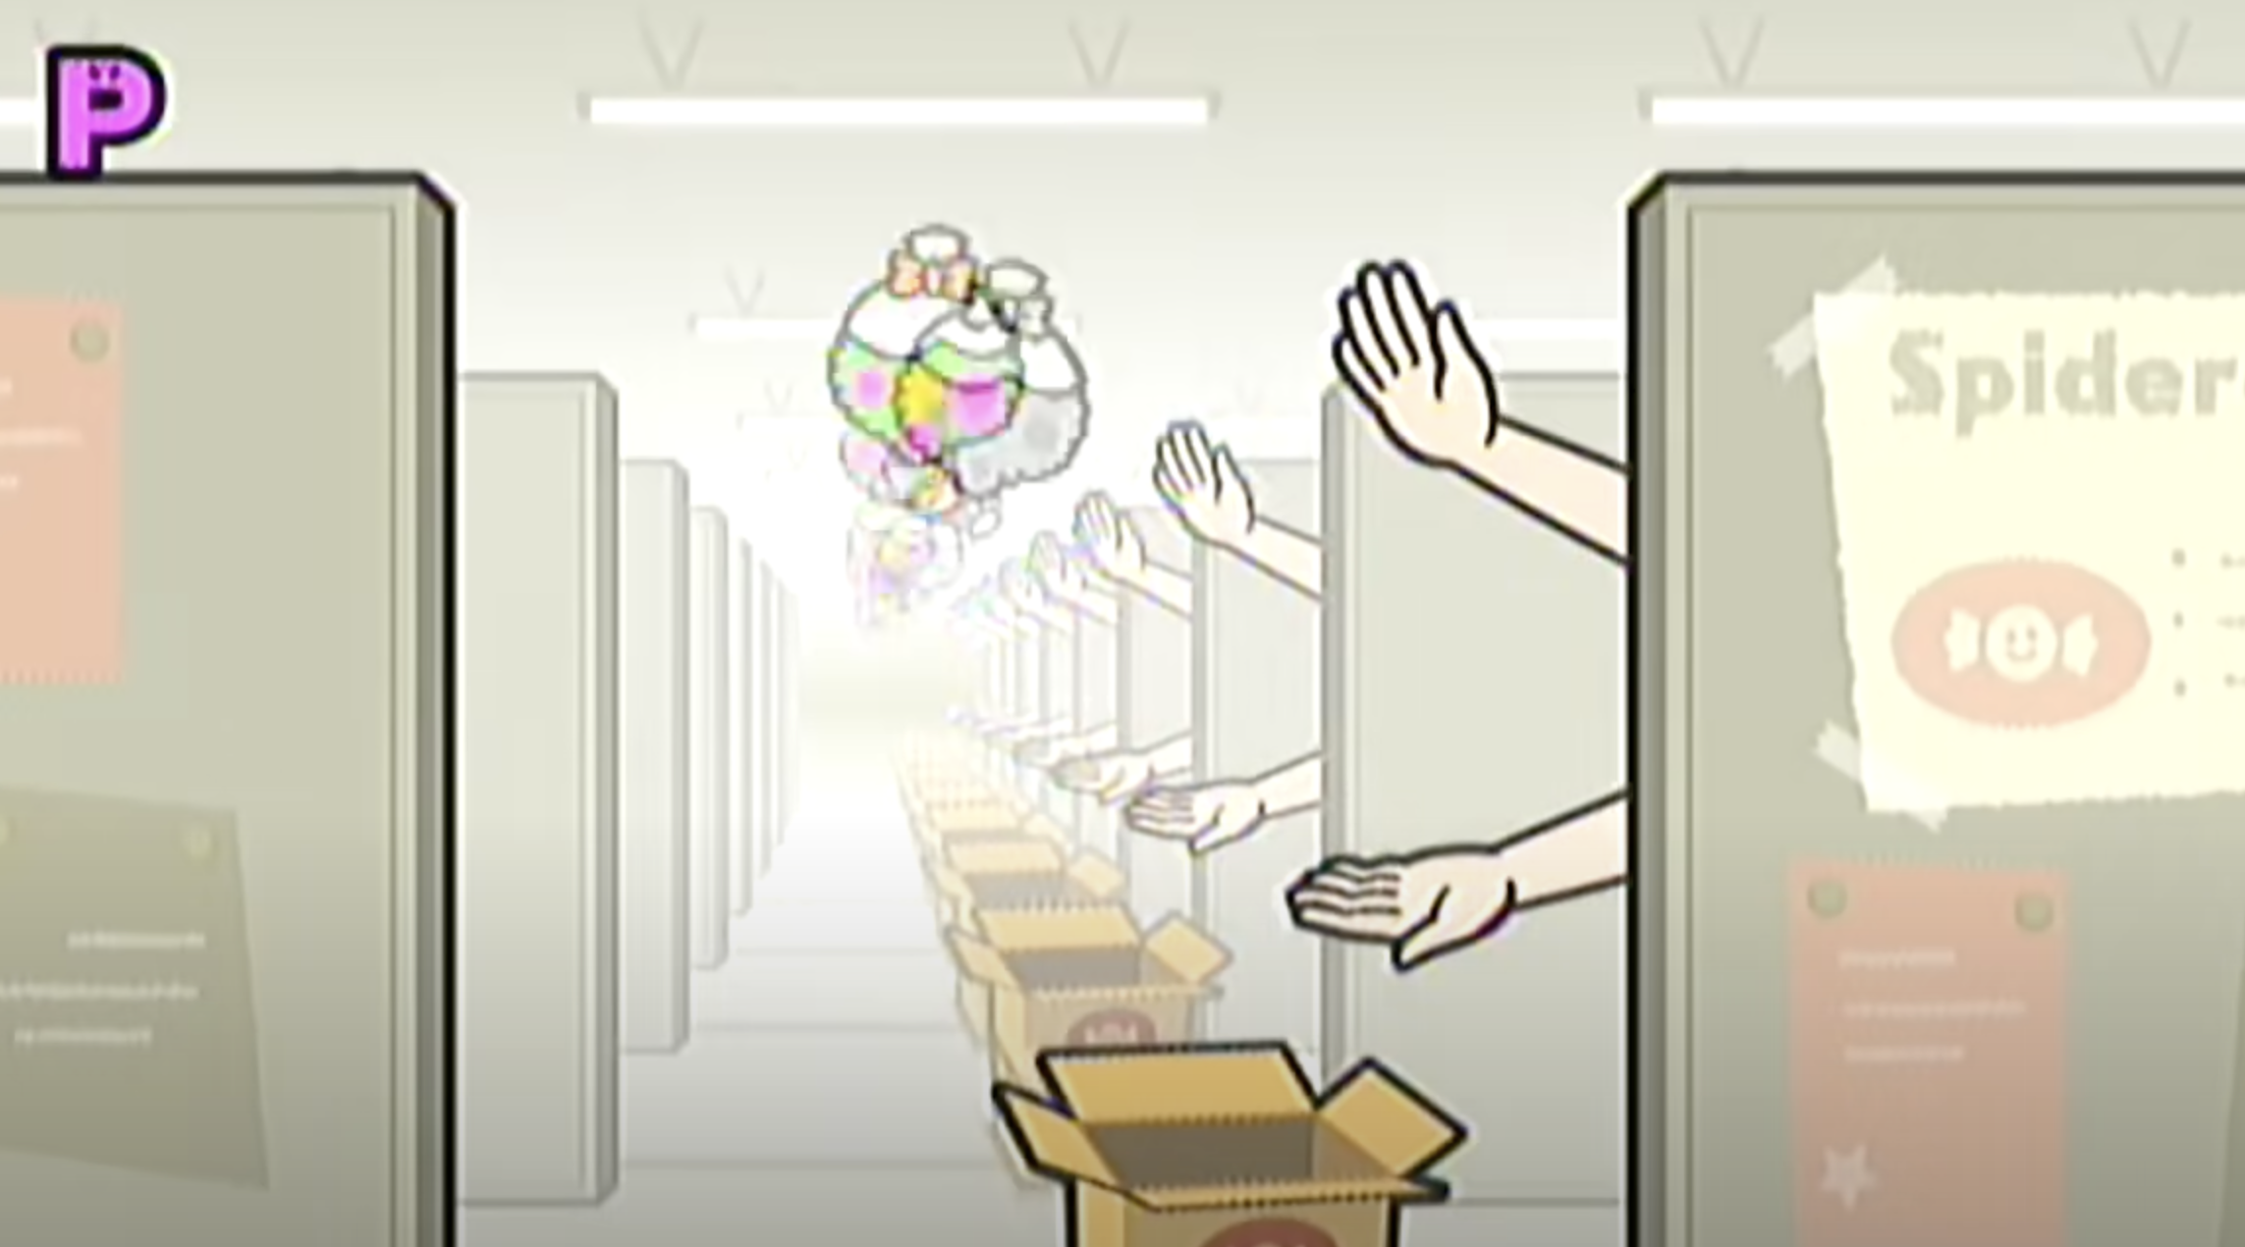
Rhythm Fitness Demonstration!
Remix 10, From Rhythm Heaven Fever (Wii)
🤣 Well-known ‘meme’ song
🕹️ Easy to control
Wii remote has only [A] and [B]
🤸 Active exercise
I have danced along this song – very tough :D.

Slide 16
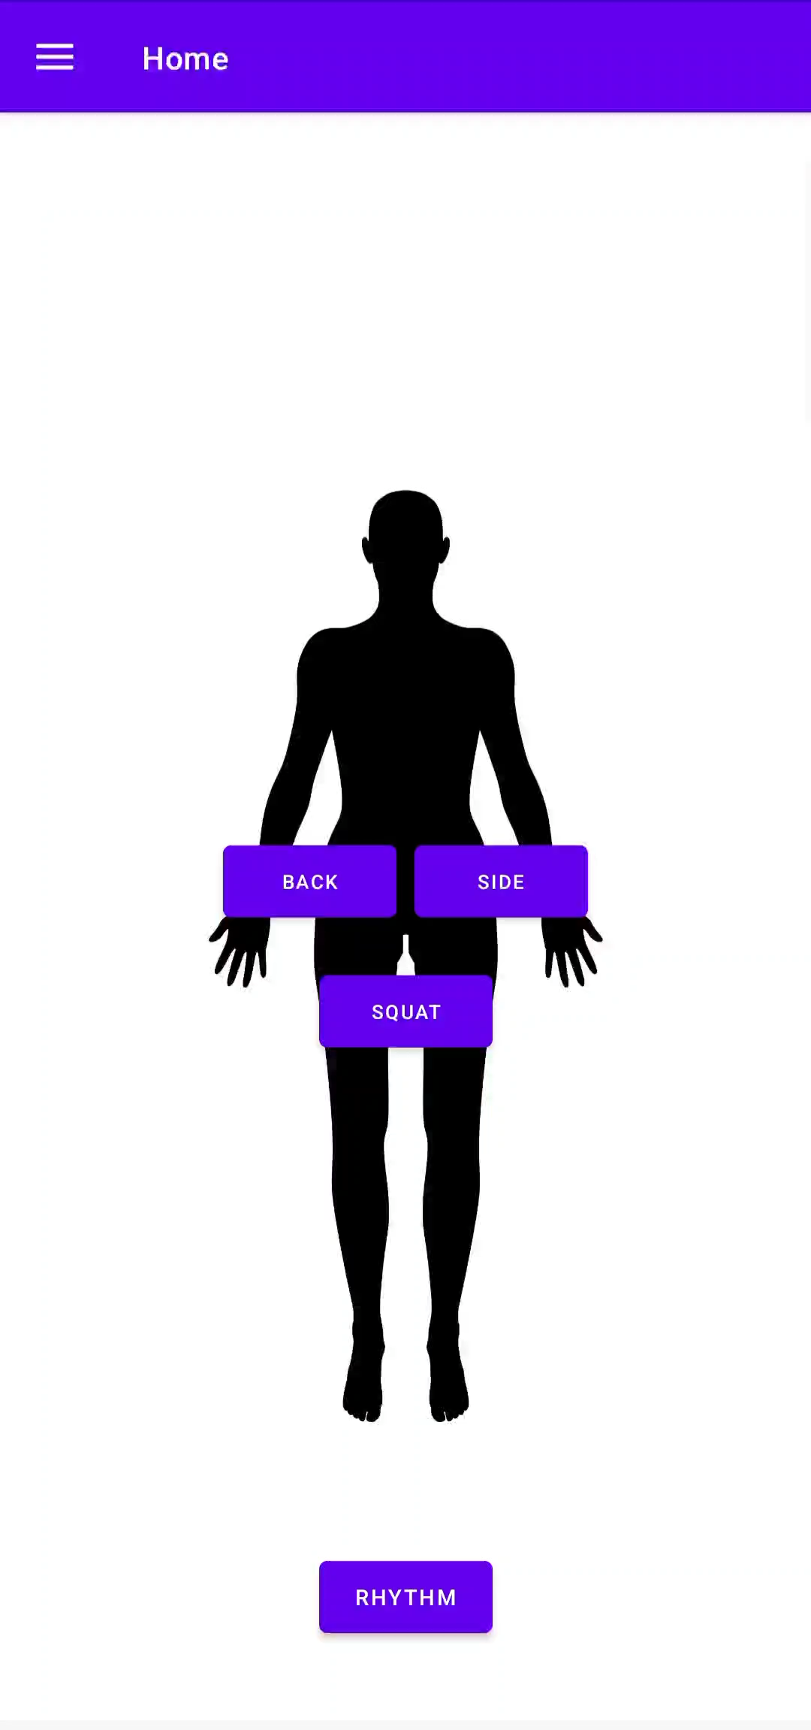
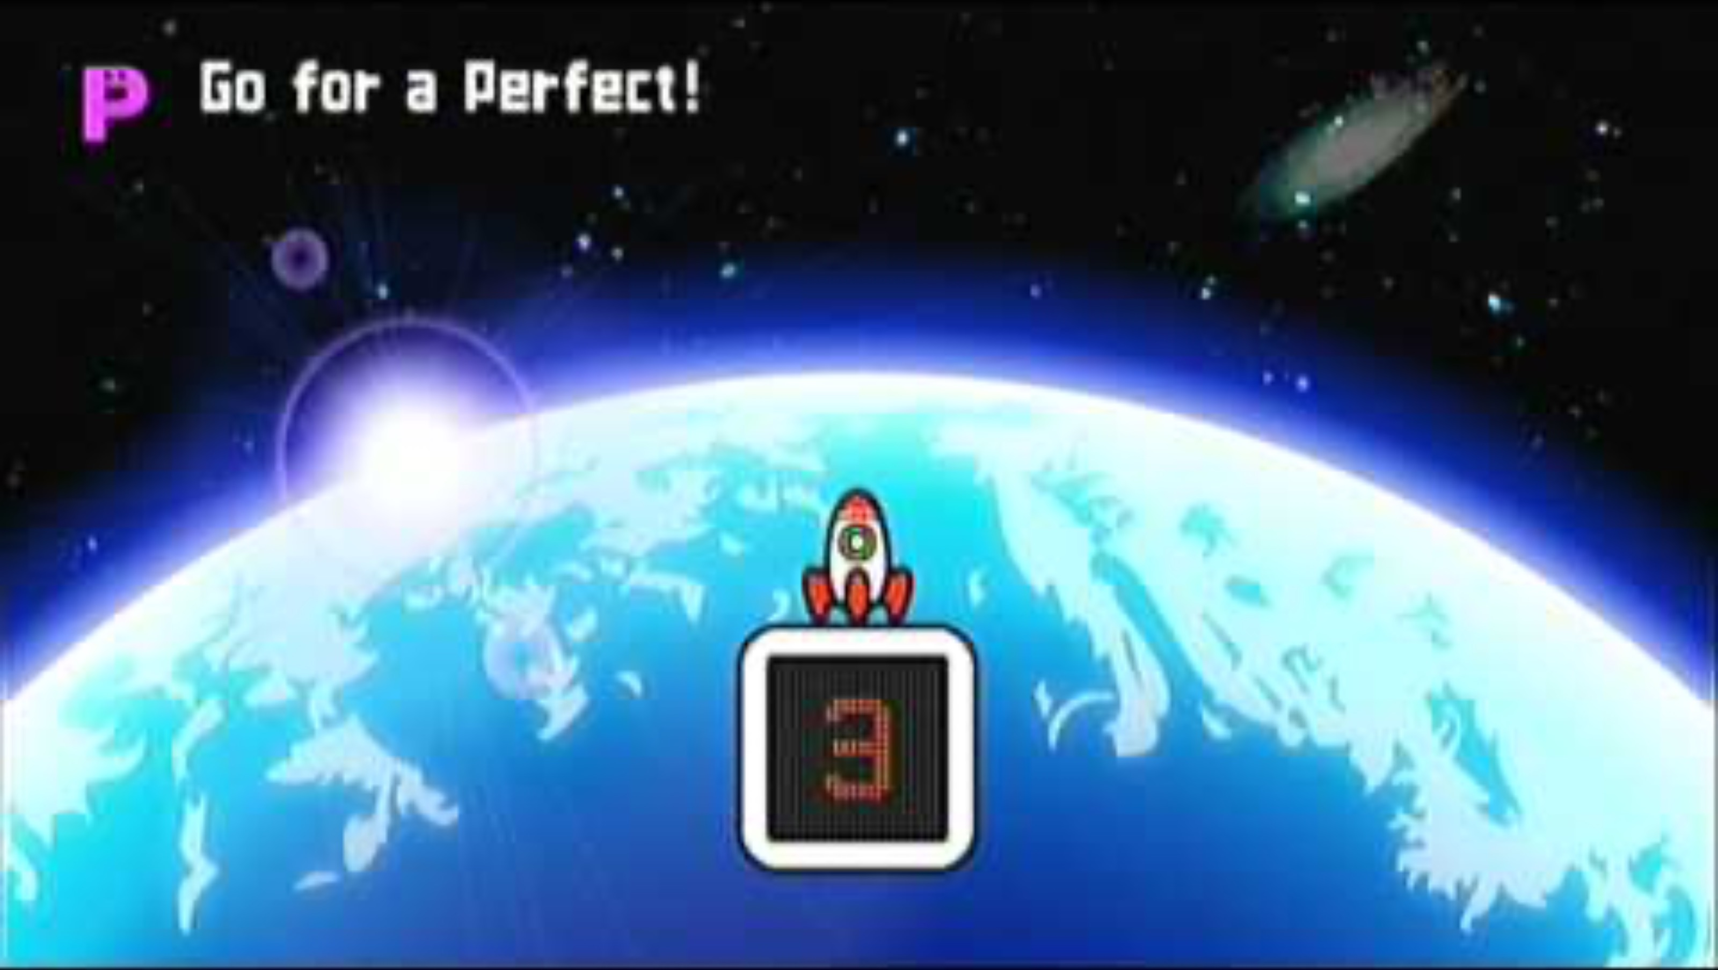
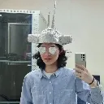
Rhythm Fitness Demonstration!
Original
Wii Gameplay Screen
PLAYED BY
Our
Implementation

Slide 17
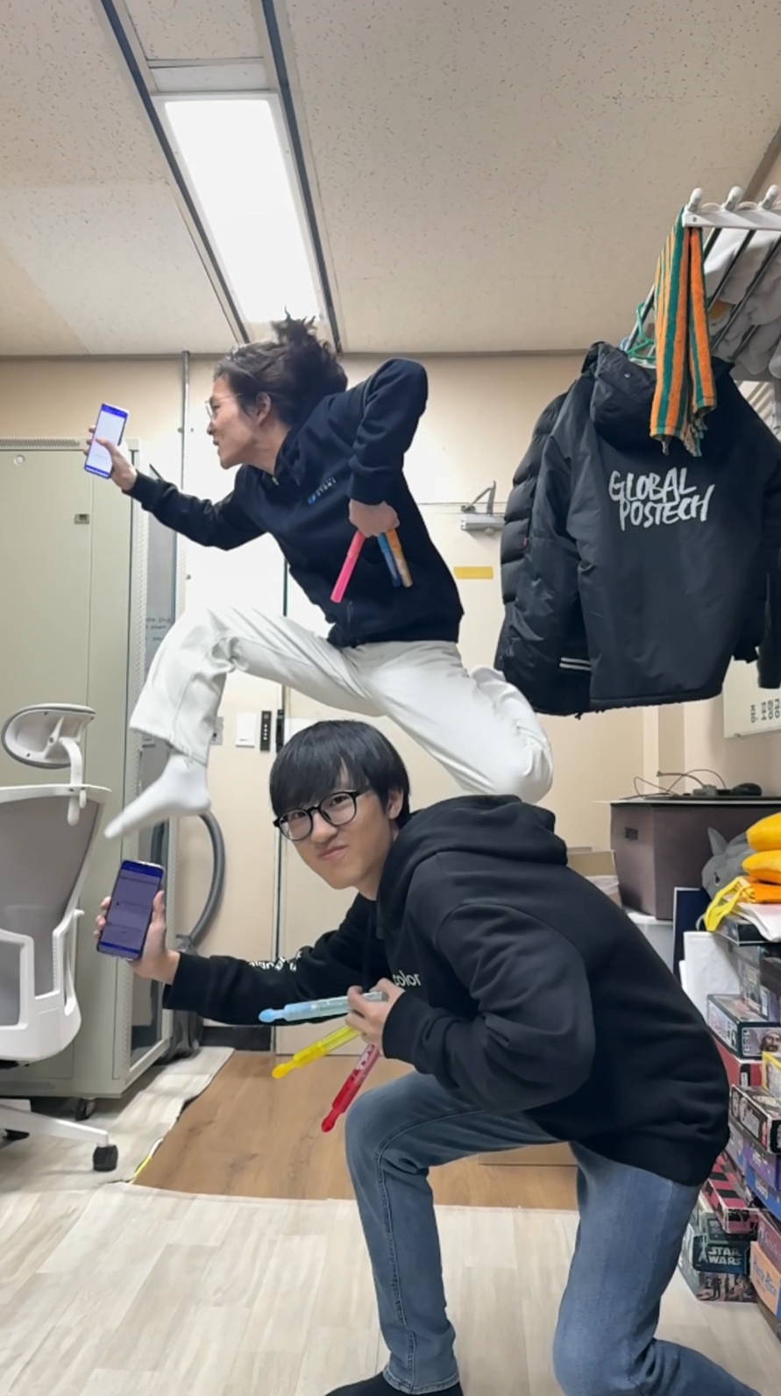
Thanks for Listening
… and Have Fun with Exercise!

